Slide 1
Lesson 9 DMA Data Transfers
LabVIEW FPGA and Host Communication
DMA FIFOs
Lossless Data Transfer
Interleaving
Notes:
Lesson Objectives
Understand that FPGA VI and host VI are inherently asynchronous.
Use DMA FIFO to control and exchange data between host and FPGA VI
Know difference between blocking and polling and impact on processor
Understand interleaving and de-interleaving channel data
Understand why the Timed Out? output of FIFO read/write is important.

Slide 2
A. LabVIEW FPGA and Host Communication
FPGA VI and host VI are inherently asynchronous
Each VI runs independently of the other
Data transfer synchronization needs to be implemented based on the application needs
Communication using front panel control and indicators is sufficient for applications that don’t require tight synchronization for control or data processing
Data buffering is required for tight synchronization and transferring large amounts of data for processing
Notes:
Communication between the FPGA VI and host VI consists of exchanging information and synchronizing the two applications.
On their own, the VIs on the host and the FPGA run asynchronously. To synchronize the VIs or to use timing information from the FPGA VI in the host VI, you must add synchronization code to your VIs.

Slide 3
Limitations of Front Panel Controls/Indicators
Only the most current data is transferred
Because FPGA VI and host VI are inherently asynchronous, data could be lost if one VI writes faster than the other reads
Large controls/indicators use significant logic resources on FPGA
Mixed-data clusters
Numeric arrays
Using CPU for host data transfer results in…
Transfer speed dependent on CPU processor speed
Slower data transfer from target to host
Consumption of CPU resources

Slide 4
Data Buffering
To transfer larger amounts of data at high rates between the target and the host you must buffer your data
The best way to buffer data is by using Direct Memory Access (DMA) data transfer methods
Buffer – An area of computer memory that stores multiple data items

Slide 5
B. DMA FIFOs
Consists of two parts – FPGA and host
Streams large amounts of data between computer memory and the FPGA
Done mostly without the CPU
Provides better performance than using the CPU to read and write data to the indicators and controls
DMA – A single FIFO transfers data to or from Host VIs by directly accessing memory.
Notes:
Emphasize the last point on this slide. Since the FPGA front panel runs on the host computer, the transfer rate from the FPGA to the host VI using front panel communication will be highly dependent upon the processor on the host.

Slide 6
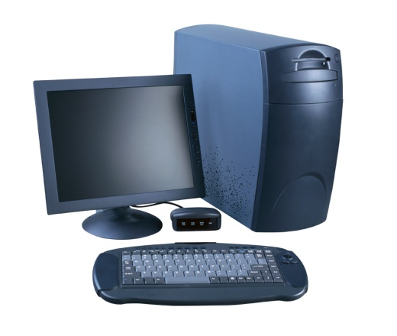
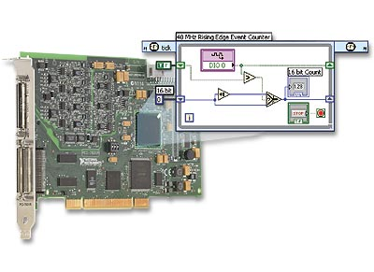
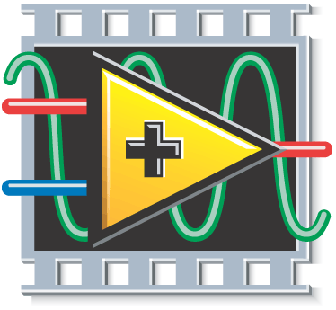
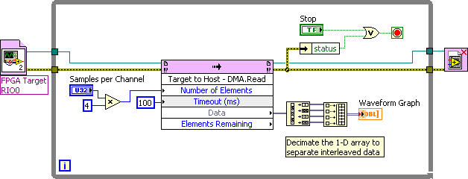

Target to Host Transfer
Data element
Buffer
read operation
Point-by-point
write operation
DMA Engine
FIFO
Local Bus
PCI Bus
Buffer
Notes:
Note: Select the back arrow (on slide in lower left corner) or left arrow (keyboard) to restart animation.
DMA uses FPGA memory to store data and then transfer it at high speed to host processor memory with very little processor involvement. This uses much fewer processor cycles when sending large blocks of data compared to the front panel indicator with FPGA Read/Write method. Here are some programming tips for implementing DMA:
When setting the FPGA buffer size, you can use the default size (1023). Creating a larger FPGA memory buffer typically does not have benefits.
If you are passing an array of data, the Number of Elements input should always be an integer multiple of the array size. For example, if you are passing an array of 8 elements, the Number of Elements should be an integer multiple of 8 (such as 80, which would give 10 samples of 8 elements each.)
Each DMA transaction has overhead, so reading larger blocks of data is typically better. The DMA FIFO.Read function automatically waits until the Number of Elements you requested become available, minimizing processor usage.
Packing 16-bit channel data into a U32 (since DMA uses U32 data type) typically does not have benefits. That’s because the PCI bus has very high bandwidth for sending DMA data, so you most likely are nowhere near to using up all of the bus bandwidth. Instead, it’s typically the processor that is the bottleneck in processing the data being streamed. Packing the data in the FPGA means it has to be unpacked on the processor, adding additional processor overhead. In general, you should send each channel as a U32 even if you are acquiring 16-bit data.
The Timed Out? output on the DMA FIFO Write function is actually an error indicator. Under normal operation this should never occur so it’s recommended that you stop the application if this error occurs and reset the FPGA before restarting.

Slide 7
Relative Transfer Rates
Slow
Speed dependent on CPU speed and availability
Data element
Fast
Fast
Fast
DMA Engine
FIFO
Local Bus
PCI Bus
Buffer

Slide 8
Buffer Data Sizes
Data element
User specifies number of elements to read
Point-by-Point
DMA Engine
Local Bus
PCI Bus
Host DMA FIFO size: Default: 10,000 elements
User modifiable
User defines
FPGA DMA FIFO size

Slide 9
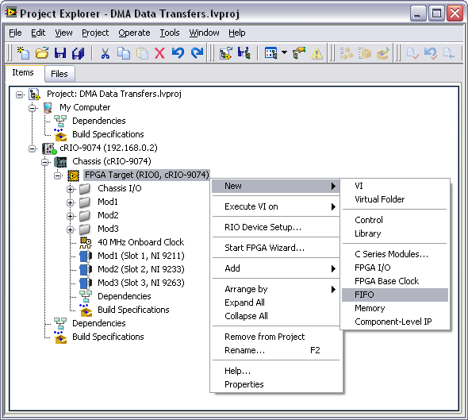
Create DMA FIFO
Notes:
Create DMA FIFOs from the Project Explorer window.

Slide 10
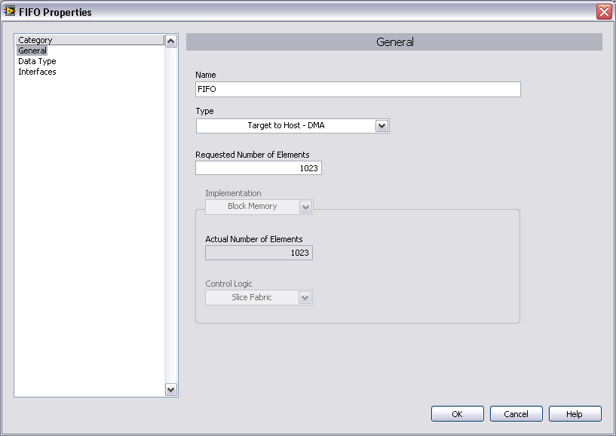
Configure DMA FIFO
Notes:
This is the same FPGA FIFO Properties
In the Type pull-down control, select either Target to Host – DMA or Host to Target – DMA.
Each DMA FIFO transfers data in one direction. Either from the host VI to the target or from the target VI to the host.

Slide 11
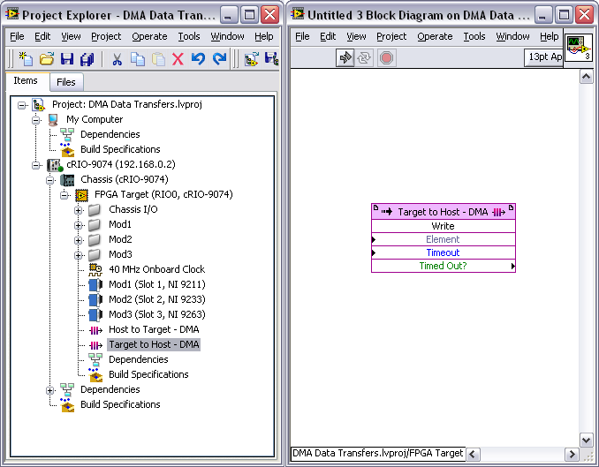
Use DMA FIFO in FPGA VI
Notes:
Place the DMA FIFO onto the block diagram of your FPGA VI by dragging it from Project Explorer window.

Slide 12


FPGA VI: DMA FIFO Write and Read
Put data into the DMA FIFO with the FIFO Write function
Retrieve data with the FIFO Read function
Use Timed Out? to determine the status of the FIFO
Notes:
Note: “DMA FIFO” is the name specified in the FIFO Configuration dialog.

Slide 13
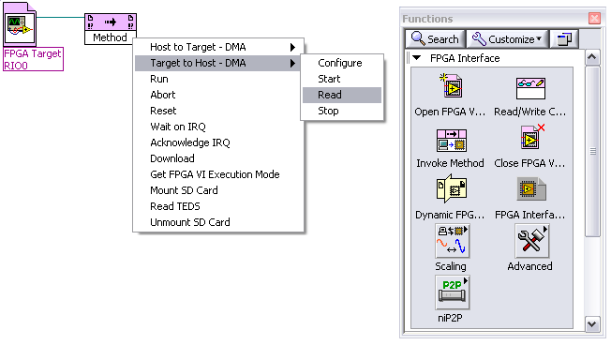
Use DMA FIFO in Host VI
Open a reference to the FPGA
Add an Invoke Method function
For a Host to Target FIFO
Choose X»Read to read data from FPGA
For a Host to Target FIFO
Choose X»Write to write data to FPGA
X is the name of the FIFO that you created in the Project Explorer
Notes:
In the screenshot, two FIFOs have been created, one is named Host to Target – DMA and the other is Target to Host – DMA.

Slide 14


Host VI: DMA FIFO Read and Write
Target to Host Transfer
Host to Target Transfer
Notes:
Instructor Note:
There are two demonstrations that visually show how data is written to and read from the host buffer. These demonstrations can be found at:
<Exercises>\Demonstrations\Host to Target DMA FIFO
<Exercises>\Demonstrations\Target to Host DMA FIFO

Slide 15
Target to Host Architectures
Blocking – Host DMA FIFO Read waits indefinitely to read a fixed number of elements from the FIFO
Polling – Host DMA FIFO Read reads all of the available elements in the FIFO at a user-defined rate.
Polling with a Fixed Number of Elements – Host DMA FIFO Read reads a fixed number of elements at a user-defined rate.

Slide 16
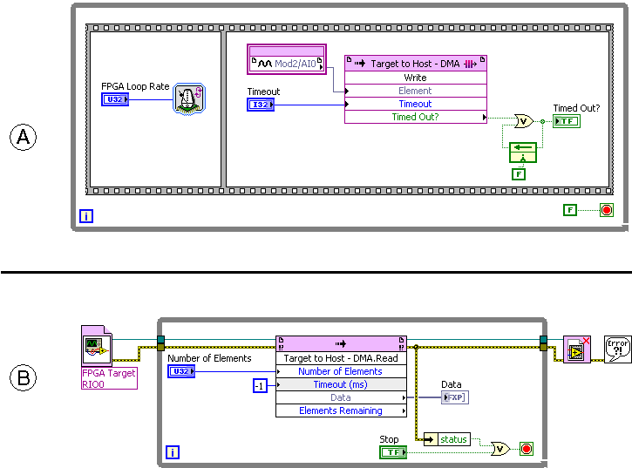
Blocking
A: FPGA VI
B: Host VI
Notes:
Blocking
User specifies number of elements.
DMA Engine waits indefinitely until the requested number of elements are available.
DMA FIFO.Read actively uses CPU while waiting for data.

Slide 17
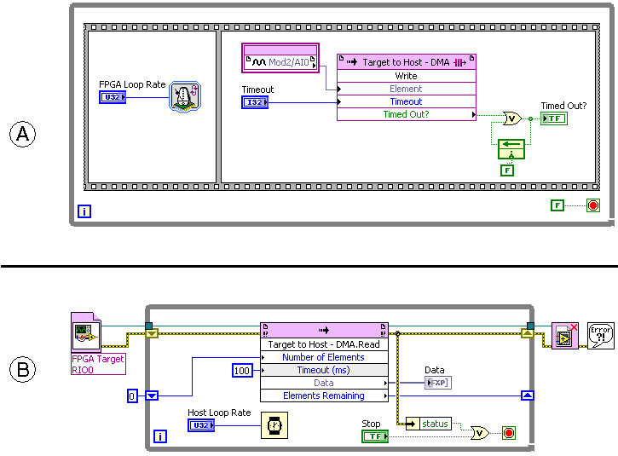
Polling
A: FPGA VI
B: Host VI
Notes:
Polling
First iteration of DMA FIFO Read returns number of elements available in the FIFO
Later iterations read the number of elements remaining after previous read
Wiring zero to Number of Elements for the first iteration quickly determines the number of elements that have already been written to the FIFO. Nothing will be returned by Data on the first iteration.
Every iteration of the Host VI will execute the read without waiting for data to be written. If there is nothing in the FIFO, then Elements Remaining will be zero.

Slide 18
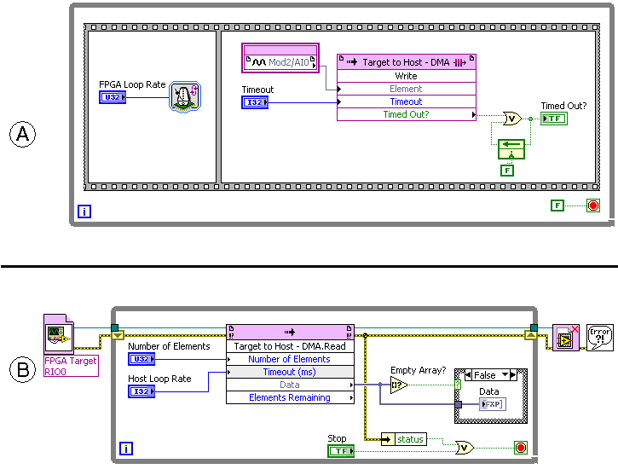
Polling with a Fixed Number of Elements
A: FPGA VI
B: Host VI
Notes:
By specifying a Timeout value for the DMA FIFO Read method, we are controlling the rate at which the DMA Read executes. Specifying the Number of Elements that are read from the FIFO controls the amount of data that is returned in each iteration of the loop.
It is generally easier to process a fixed amount of data being returned at a fixed rate than to process a fixed amount of data at a variable rate (blocking) or a variable amount of data at a fixed rate (polling).
For this example, no processing is taking place aside from displaying the data on the front panel. Checking whether or not the Data array is empty tells us whether or not the DMA Read timed out. If there is no data returned, then the read timed out and we do not have to execute the processing code, which should reside in the False case of the Case Structure. You could handle the fact that no data was returned in the True case.

Slide 19
C. Lossless Data Transfer
Selecting FIFO Size
FPGA VI
Host VI
Ensuring lossless data transfer
Handling overflow
Handling underflow

Slide 20
Selecting FIFO Size
FPGA VI
In the FPGA FIFO Properties dialog box, use Number of Elements to set the size of the FPGA FIFO on the FPGA
Save resources by choosing the smallest size that is reasonable for your application
Host VI
Default is 10,000 elements
Use a Configure Method to specify a different size

Slide 21
Ensuring Lossless DMA Transfer
Overflow – FIFO is filled as a result of data being written faster than it is read, data may be lost
Reduce the rate at which you write data to the FIFO
Increase number of elements to read on host
Increase FPGA/host buffer sizes
Reduce load on CPU
Speed of CPU and competing tasks impact transfer rate from DMA to application memory
Notes:
The speed of the overall DMA transaction is limited by the processor (windows, real-time). The processor isn’t use for DMA transfer but the processor is used to copy the memory from DMA to application memory. Speed of CPU and competing tasks limit the availability of CPU resources.
With 10,000 elements on host, increasing host side isn’t likely the problem for most applications.

Slide 22
Ensuring Lossless DMA Transfer
Underflow – FIFO is emptied as a result of data being read faster than it is written, timeout is generated
Increase timeout
Read less frequently
Read smaller sets of elements

Slide 23


Handling Overflow and Underflow
Overflow – Check whether or not the Write Method timed out
Underflow – Check for error –50400 on the DMA Read method
Notes:
These same techniques can be used in reverse for Host to Target transfers. In that case, the Timed Out? output of the FPGA Read method would indicate an underflow condition and error -50400 on the Host Write would indicate an underflow condition.

Slide 24
Recovering from a FIFO Overflow
There are two primary methods for clearing the FIFO when an overflow occurs, depending on whether or not you want to keep the data that is in the FIFO
Reset the FPGA VI – Discards the data in the FIFO
Flushing the buffer – Reads the remaining data in the FIFO
Either method can be performed to initialize the FIFO at the beginning of execution

Slide 25

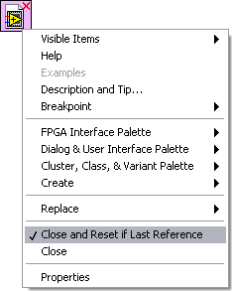
Resetting the FPGA VI
Execution on development computer
FIFOs automatically reset when the VI stops and restarts
Execution on FPGA Target
FIFOs do not automatically reset
To reset programmatically:
Use the Invoke Method function Or
Use the Close FPGA VI function configured to Close and Reset if Last Reference

Slide 26

Flushing the Buffer
Find out how much data remains in the FIFO
Read all of the remaining elements from the FIFO

Slide 27
Exercise 9-1 Custom Triggering
Develop an FPGA VI that waits for multiple trigger conditions to be met before acquiring analog data and writing to a DMA FIFO for transfer to the RT Host.
Notes:
Prep discussion:
Custom triggering is commonly used in FPGA applications that perform I/O.
You will implement custom triggering to control when analog input will be collected and transferred to the host VI via DMA FIFO.

Slide 28
Exercise 9-1 Custom Triggering
What are the benefits of implementing a custom trigger on the FPGA?
Which polling or blocking method was used to read the FIFO in the Host VI?
How did your code handle overflow/underflow?
Notes:
Triggering on the FPGA is processed much more quickly than it can be on Windows. Since the trigger was based on an analog input that was obtained from an I/O resource on the FPGA, we were able to write FPGA code that would read that value, compare it to the threshold values and perform the triggering without any processing of the trigger occurring on the host.
This application used polling with a fixed number of elements to acquire the data from the DMA FIFO.
Underflow was handled in the host VI by checking the DMA Read method for error -50400. If that error occurred, the error cluster was cleared. If that error did not occur, then the desired number of elements had been read and the host and FPGA VIs were stopped.

Slide 29
D. Interleaving
There is a limited number of DMA FIFO channels available
Three channels available for NI 7831R and cRIO-9074
What if you want to acquire and transfer data from multiple channels on multiple modules?
You can interleave data of the same type prior to writing to the DMA FIFO

Slide 30
Interleaving – FPGA VI
Combine multiple elements of the same data type into a single array
Module 1 Channel 0 → Index 0
Module 1 Channel 1 → Index 1
Etc…
Iterate through that array, writing the data one element at a time to the DMA FIFO

Slide 31
De-Interleaving – Host VI
Read data from the DMA FIFO
Divide the data into multiple arrays, each representing a single channel of acquisition
Process the data for each channel

Slide 32
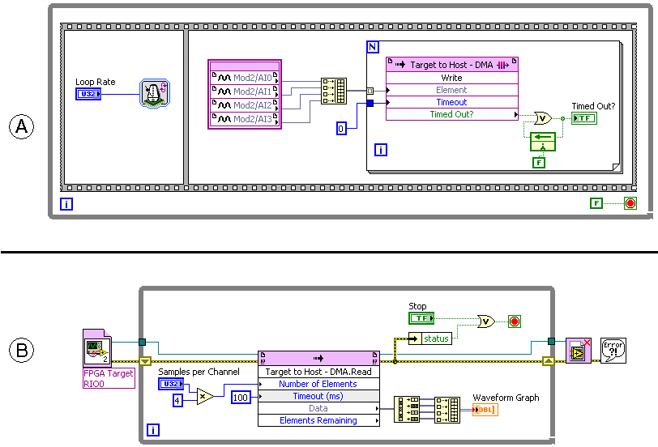
Interleaving - Example
A: FPGA VI
B: Host VI
Notes:
Interleaving
FPGA VI – Write multiple channels of data to a DMA FIFO by interleaving.
Host VI – Read multiple an array of data from a DMA FIFO in the host and decimate the array to separate the data into different channels.

Slide 33
Exercise 9-2 AI Interleaved DMA
Create an FPGA VI that uses DMA FIFOs to transfer analog data from multiple devices and channels from the FPGA target to the RT Host using the blocking method of data transfer.
Notes:
Prep discussion:
You create an FPGA VI that uses DMA FIFOs to transfer analog data from multiple devices and channels from the FPGA target to the RT Host.
Since our FPGA device only has three DMA channels, we cannot use a separate DMA FIFO for each I/O resource.

Slide 34
Exercise 9-2 AI Interleaved DMA
Which polling or blocking method was used to read the FIFO in the Host VI?
What purpose does the Feedback Node serve in the FPGA VI?
What is the largest Samples per Channel value that you could acquire before causing an overflow condition to occur?
Notes:
This application used blocking to wait indefinitely at the Read Method in order to acquire all of the requested data.
The Feedback Node is used to latch whether or not an overflow condition ever occurred during the Write Method. It stores the value of Overflow Occurred from the previous iteration of the loop and passes that value into the compound OR function for the next iteration so that Overflow Occurred will remain True if that condition was ever met. The same functionality could have been implemented with a shift register.
The FPGA portion of the FIFO was configured to contain 1023 elements and the host buffer contains 10,000 elements by default, so the FPGA portion of the FIFO will be our limiting factor. We are acquiring data from two I/O resources per DMA channel, so we could acquire 1023/2 = 511.5 → 511 samples before causing an overflow condition.

Slide 35
Summary—Quiz
Identify whether each of the following statements describes communication using front panel controls/indicators or a DMA FIFO.
Well-suited to streaming large amounts of data
Consumes significant CPU resources
Only the most recent data is transferred
Suitable for use in asynchronous applications

Slide 36
Summary—Quiz
Identify whether each of the following statements describes communication using front panel controls/indicators or a DMA FIFO.
Well-suited to streaming large amounts of data - DMA FIFO
Consumes significant CPU resources - front panel controls/indicators
Only the most recent data is transferred – front panel controls/indicators
Suitable for use in asynchronous applications – DMA FIFO
Notes:
Well-suited to streaming large amounts of data – DMA FIFO
Consumes significant CPU resources – Front Panel Communication
Requires that LabVIEW switch to the user interface thread to complete execution – Front Panel Communication
Suitable for use in asynchronous applications – DMA FIFO

Slide 37
Summary Quiz
You have developed an application that acquires data and uses a DMA FIFO to transfer data to a host VI. However, the DMA FIFO repeatedly fills, resulting in an overflow condition. Which of the following techniques can be used to address this problem? (Multiple Answers)
Reduce the speed of acquisition on the FPGA VI
Increase the number of elements to read on the host
Decrease the rate at which the host reads data
Increase the rate at which the host reads data

Slide 38
Summary Quiz Answer
You have developed an application that acquires data and uses a DMA FIFO to transfer data to a host VI. However, the DMA FIFO repeatedly fills, resulting in an overflow condition. Which of the following techniques can be used to address this problem? (Multiple Answers)
Reduce the speed of acquisition on the FPGA VI
Increase the number of elements to read on the host
Decrease the rate at which the host reads data
Increase the rate at which the host reads data
Notes:
A, B, and D are all valid approaches to solving a FIFO overflow problem.

Slide 39
Summary Quiz
Match each target to host architecture to the description that best fits it.
Polling with Fixed Number of Elements
Polling
Blocking
Host DMA FIFO Read reads a fixed number of elements at a user-defined rate
Host DMA FIFO Read waits indefinitely to read a fixed number of elements from the FIFO
Host DMA FIFO Read reads all of the available elements in the FIFO at a user-defined rate

Slide 40
Summary Quiz Answer
Match each target to host architecture to the description that best fits it.
Polling with Fixed Number of Elements
Polling
Blocking
Host DMA FIFO Read reads a fixed number of elements at a user-defined rate
Host DMA FIFO Read waits indefinitely to read a fixed number of elements from the FIFO
Host DMA FIFO Read reads all of the available elements in the FIFO at a user-defined rate
Notes:
Polling with a Fixed Number of Elements – A. Host DMA Read reads a fixed number of elements at a user-defined rate
Polling – C. Host DMA Read reads all of the available elements in the FIFO at a user-defined rate
Blocking – B. Host DMA Read waits indefinitely to read a fixed number of elements from the FIFO

